Slide 1
Network Python Programming and Encryption
Presented by Christopher Doege

Slide 2

Prelude

Slide 3

About Me
Graduated from UTSA
Enjoy Reverse Engineering, CTFs, Crypto and sporadic development
Twitter:
@Chris_Doege
Github:
Github.com/cdminigun

Slide 4
Presentation Assumptions
Some knowledge of a scripting language
Or the ability to learn
Python Version – 2.7x
Everything but print statements transfer to 3.x
Basic understanding of OS / Networking
Most will be covered
Tried to abstract away the math from crypto
Math is generally required for rigorous definition
Please save questions till after the talk!

Slide 5
Networking Intro
OSI Model
Application
Presentation
Session
Transport
Network
Datalink
Physical

Slide 6
TCP
Connection Oriented
Three-way handshake between two endpoints
Reliable
No error checking is necessary at app layer
Stream based
No predefined blocksize
Processes identified by port
Services live at specific ports

Slide 7
UDP
Datagram based
Connectionless and unreliable
Can multicast / broadcast
Essentially ‘Hail Marrys’ data across the network
Error checking relies on the programmer
No reliability
Relatively no overhead
Processes identified by port number

Slide 8
Types of Sockets
SOCK_DGRAM
UDP
Unreliable
Can Send or receive
SOCK_STREAM
TCP
Reliable
In order
Bidirectional

Slide 9
Creating a Socket Object
Types of sockets
tcp_sock = socket.Socket(socket.AF_INET, socket.SOCK_STREAM)
udp_sock = socket.Socket(socket.AF_INET, socket.SOCK_DGRAM)
New Socket object
Allows for binding and communication

Slide 10
Assigning a port (Server Side)
Ports are addressable up to Max short(~65535)
Well known ports are 1024 and below
These ports require admin / root privs to assign
Port 0
In socket binding, allows the OS to assign the port
sock.bind((ip_addr, 0))

Slide 11
Assigning an IP Address (Server Side)
AF_INET / PF_INET
IPV4
Technically range from 0.0.0.0 to 255.255.255.255
Certain ranges are reserved
AF_INET6
IPV6
Binding to all interfaces:
Set IP to 0.0.0.0
Binds to all interfaces
sock.bind((0.0.0.0, port))

Slide 12
Client / Server Paradigm
Client initiates request
Sends required data
May wait for data back from the server
Server handles request
Waits until data is received
Processes Data
May respond to client

Slide 13
Client – TCP
import socket
s = socket.socket(socket.AF_INET, socket.SOCK_STREAM)
s.connect((127.0.0.1, 1234))
s.send(“hello”)
data = s.recv(1024)
print data

Slide 14
Server – TCP
import socket
s = socket.socket(socket.AF_INET, socket.SOCK_STREAM)
s.bind((‘127.0.0.1’, 1234))
s.listen(10)
while 1:
conn, addr = s.accept()
a = conn.recv(1024)
print a
conn.send(a)

Slide 15
Client – UDP
import socket server = ((‘127.0.0.1’, 1234))
s = socket.socket(socket.AF_INET, socket.SOCK_DGRAM)
s.bind((‘127.0.0.1’, 0)) #OS decides port
s.sendto(“hello”, server)
data, addr = s.recvfrom(1024)
print data

Slide 16
Server – UDP
import socket
s = socket.socket(socket.AF_INET, socket.SOCK_DGRAM)
s.bind((‘0.0.0.0’, 1234))
while 1:
data, addr = s.recvfrom(1024)
print data
s.sendto(data, addr)

Slide 17
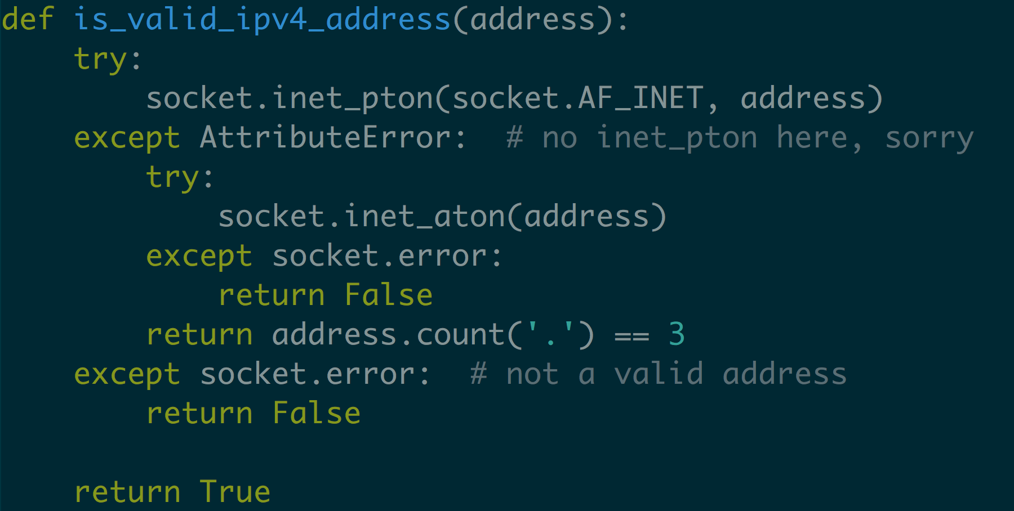
Helper Function

Slide 18
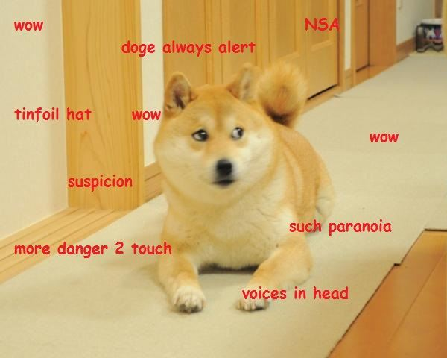
Crypto

Slide 19
Types of Crypto
What should we use?
Hashing?
HMAC
Symmetric?
AES-CBC
AES-ECB
Really bad
Sometimes the default for bad cryptosystems
Asymmetric?
RSA
PKI?
Needs proper infrastructure

Slide 20
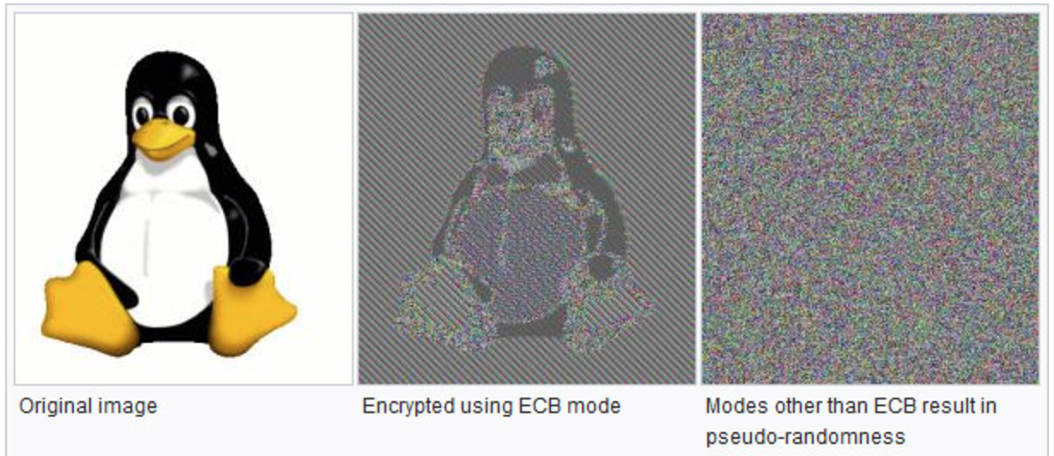
Block Cipher (detour)
What is a block cipher?
Divides a message into blocks
ECB
Encrypts each block with the same key
CBC
Alternates using an IV, password and previous blocks

Slide 21

Implementing Crypto (Real World)
Like pulling teeth
Everyone is opinionated
The right tools are hard to find
In house crypto? ☹
What layer?
Application Layer
TCP Layer
IP (Network) Layer
Mac (Link) Layer

Slide 22
Pros and Cons (by layer)
Application
No underlying implementation
Vulnerable to MITM
TCP
End to End encryption
IP data unencrypted
Easily Altered
IP
End to end of Layer 3 devices
Requires standardization across L3 devices
Mac (Link)
Full End to End encryption
Extremely high overhead

Slide 23
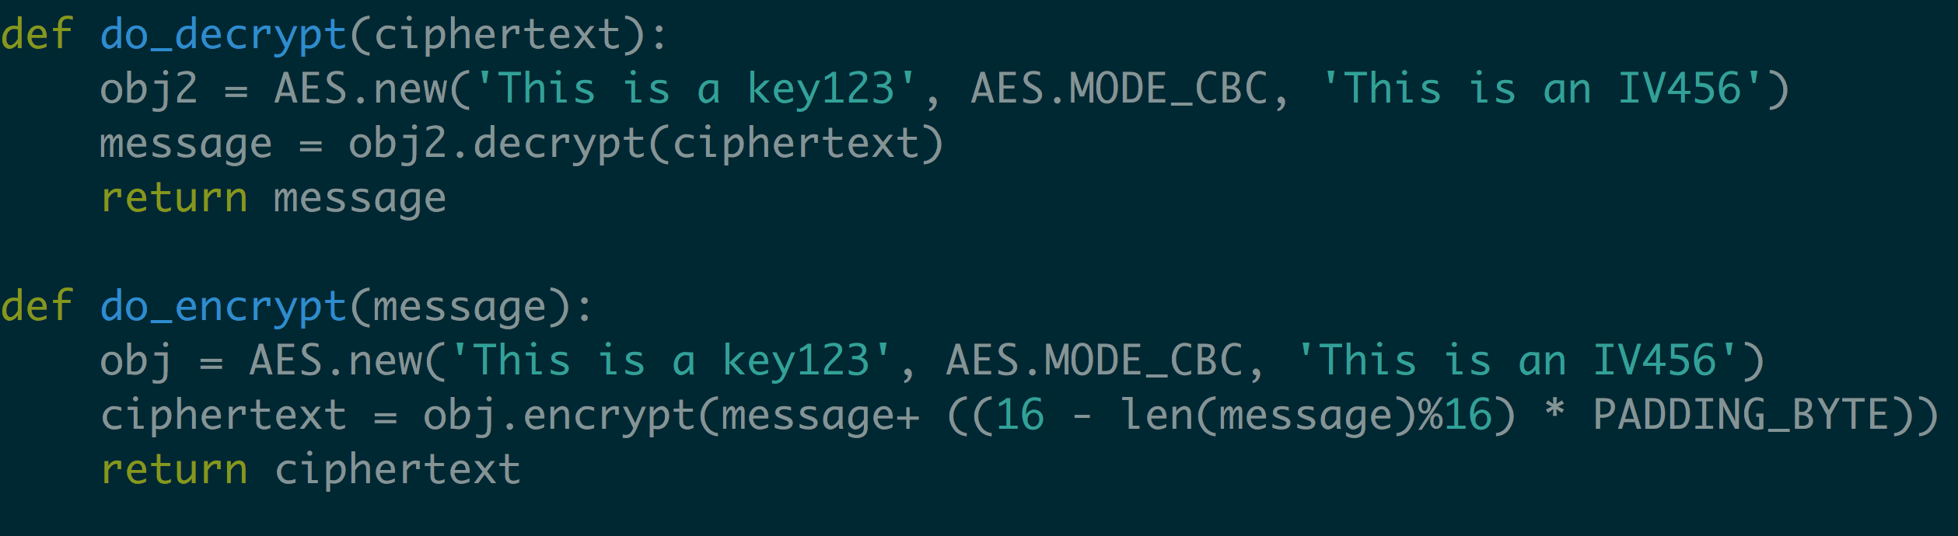
Application Layer Example
Toy Example

Slide 24
Is this actually secure?
Not really…
AES-CBC with known IV (publicized)
Insecure against Chosen Plaintext Attack (CPA)
Should possibly be randomized / decided through diffie hellman
IP/TCP header information exposted
Vulnerable to MITM attacks

Slide 25
Takeaways
High level understanding of:
Networking (UDP/TCP)
Functions in python for TCP/UDP
Status of Crypto
Layers that Crypto can be implemented
Problems in Crypto
All programs and slides can be found at:
Github.com/cdminigun/SABSides2017/

Slide 26
Future Reading / Good Reads
https://littlemaninmyhead.wordpress.com/2017/04/22/top-10-developer-crypto-mistakes/
Great explanation of failures and ways to fix them
https://crypto.stackexchange.com/questions/3883/why-is-cbc-with-predictable-iv-considered-insecure-against-chosen-plaintext-atta
Explanation of CBC IV attack (Warning, Math)

Slide 27

Fin – Questions?

